Slide 1
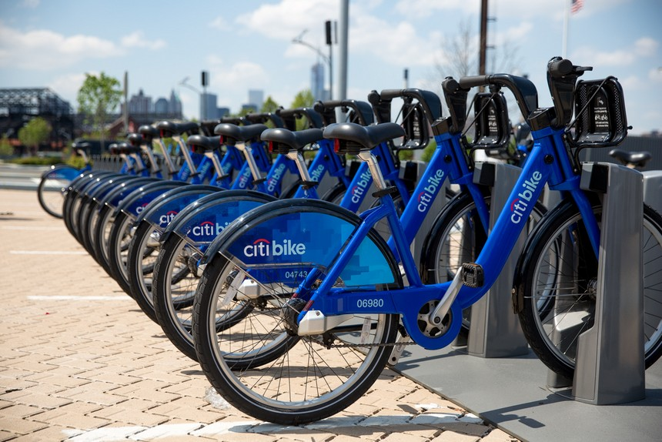
36,000,000 Trips and Counting: An Analysis of Citi Bike Metrics
Hilda Vargas
Springboard Data Science Intensive Workshop Winter 2016 – 2017

Slide 2



The Data
Notes:
Trip Duration
Trip Start Date
Gender of user for every trip
Year of Birth of user – people lying about their age (outliers)
Dropped null birth years
Dropped outliers – birth years <1920
Start station name, lat, long
End station name, lat, long
Data is publicly available on Citi Bike’s own website
42 files, one for every month/year combo between CB’s inception (July 2013) to December 2016
All fields are aligned in each file
Over 36,000,000 observations/trips – LOTS of data
Limitations – no unique identifier per user, so counting number of rides taken by specific demographics

Slide 3
The Problem
How can we use the available data to create a meaningful artifact that can be used to guide Citi Bike’s marketing team advertising decisions?
Notes:
Create a dashboard with key metrics that can be measured over specific chosen periods of time!
Questions I chose to focus on:
Where are Citi Bike stations located in New York City?
What are the 10 most popular stations?
What are the number of trips taken by age range and gender?
What is the average trip duration based off age and gender?
What are the most popular times for Citi Bike use?

Slide 4

The Approach
Notes:
Python!!
User-friendly programming language, easy to manipulate, good for data visualization and manipulation, which is key for answering the questions I just outlined
Great for working with large and/or multiple files
Well-documented (syntax, documentation)
Lots of smaller libraries and packages that are based off of it

Slide 5
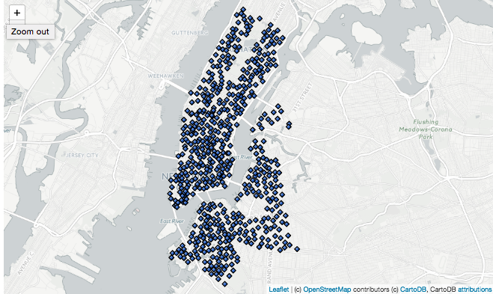
The Results Current Citi Bike Stations
Notes:
609 stations all over the city (using 12/2013 to estimate)
Well-represented in lower and middle Manhattan, not as much in upper manhattan
Also many stations in Brooklyn and a couple in Queens, but there is more that could be done in terms of expansion

Slide 6
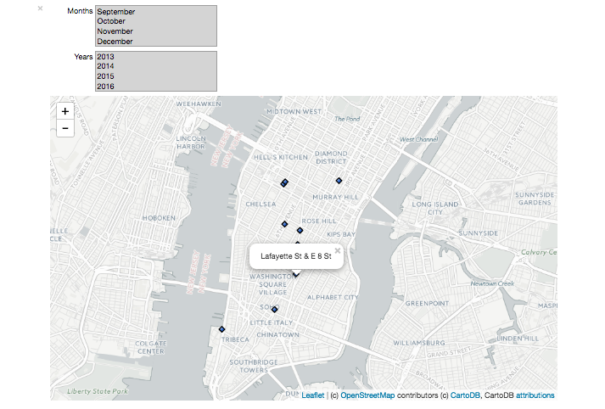
The Results 10 Most Popular Citi Bike Stations
Notes:
Demonstration of map plot
Most popular stations are generally located near Grand Central (42nd street), Chelsea, the East Village, and Tribeca, which intuitively makes sense because these are very popular areas in New York City for renting apartments and office spaces and nightlife.
None of the top 10 stations were located in Brooklyn for any of the month/year combos I tried – surprising, could mean that perhaps we can do more marketing in BK or perhaps this has something to do with ownership of bikes in that area
Station located at 60th street and Broadway decreased in popularity, while the station located on 40th street and 12th avenue increased in popularity between 2013-2016
Focus on marketing and advertising in Brooklyn and upper parts of Manhattan
Consider creating a promotional campaign to increase ridership in the less popular areas.

Slide 7
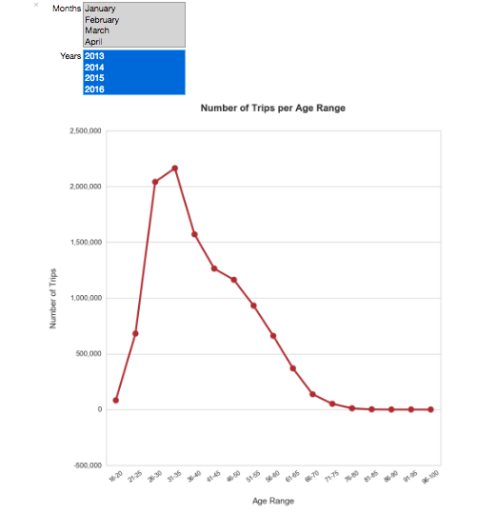
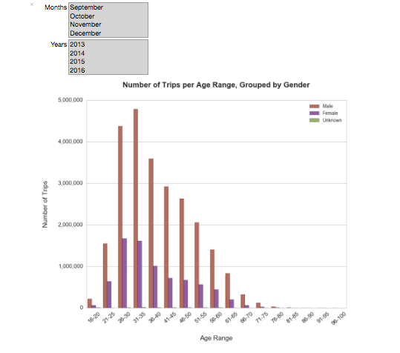
The Results Number of Trips Taken per Age Group, Gender
Notes:
Point plot shows users who are between 31-35 years old take the overwhelming majority of rides and consistently have for the last couple of years
People who are 26-30 years old take the second most trips and consistently have for the last couple of years
36-50 years old take the third most trips and consistently have for the last couple of years
As expected, the number of trips increased between the months of March-August, and decreased from November-February
Between 2013 and 2015, few rides were taken by millennials aged between 21-25. Users between the ages of 36 and 50 years old took between 2-3 times more rides than riders aged 21-25.
However, in 2016, the number of rides taken by millenials nearly equaled the rides taken by those who are 36-50 years old.
16-20 age group accounts for very few rides. In the three and a half years that the dataset encompasses, people in this age range took approximately 300,000 rides. This may be due to parents’ safety concerns.
bar plot illustrating the number of rides taken per age group, grouped by gender = large disparity in the rides taken by men and women.
In every month of every year, men accounted for at least 2X as many rides as women.
Women have only taken approximately 8 million rides out of the 36,902,025 total trips taken in July 2013–December 2016 (less than 25% of the total Citi Bike trips taken, assuming that people told the truth about their gender)
Because so few users’ genders are unknown, we can easily estimate that the other ~75% of rides were taken by men.
Focus on advertisements targeted towards women and milennials to increase ridership amongst these groups

Slide 8
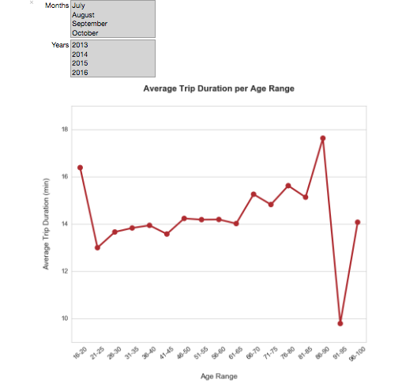
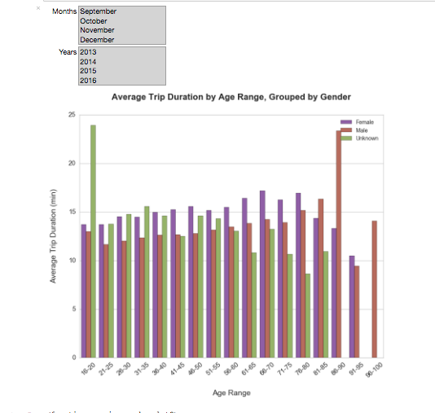
The Results Average Trip Duration per Age Group, Gender
Notes:
Groups with the highest average trip duration were 16-20 and 75+. This is most likely due to the fact that there were so few rides taken by people in these age ranges.
As expected, the average trip duration for all age groups increased over the spring and summer months, but only by 1-3 minutes, which was not expected (perhaps because biking is not ideal in the hot summer months)
I was quite surprised that on average, Citi Bike trips have only been 12-16 minutes long, historically. This might be because most people use the bikes to go to work and not for leisurely activities
women’s trip durations are longer than men for almost every age group. Although the difference is quite small, I was surprised because of how many more rides have been taken by men than women.
Consider creating promotional campaigns with special subscriptions for women. For example, now that we know that most trips taken by women are about 15 minutes long, the marketing team could attempt to increase ridership by offering a certain amount of minutes for free for every 15-minute bike ride. This decision would have to be made depending on other business metrics,

Slide 9
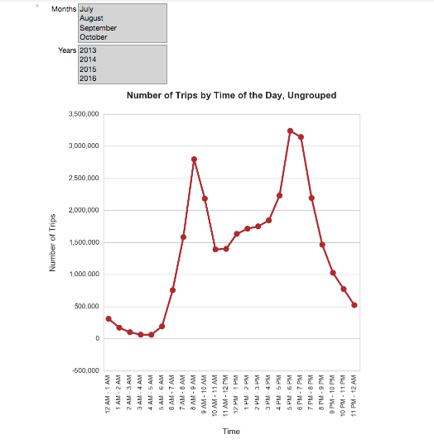
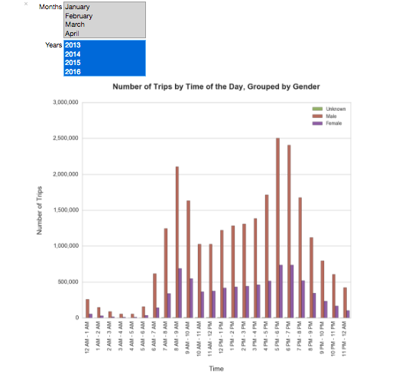
The Results Most Popular Times of the Day per Gender
Notes:
Could use this information to increase ridership during times of the day that are less popular for riders by providing discounted prices for bike rentals during these time periods.
Unsurprisingly, most Citi Bike trips are taken between 6 AM – 10 AM, corresponding to the times at which many arrive to work, and 4 PM – 9 PM, the interval at which many go home from work.
As expected, more rides were taken at later times of the day in the warmer months, while this number decreased in the colder months. These observations held true for both the ungrouped point plot and the barplot grouped by gender.

Slide 10
Possible Extensions of This Work
Notes:
Predicting the impact of weather on ridership per gender and/or age group
Gaining a better understanding of the demographics of Citi Bike users by tying in census data such as income, occupations etc.
A look at the most popular routes amongst different demographics of Citi Bike users

Slide 11
Questions? Thank you!

